Slide 1

Department of Computer Science and Engineering CSB4243 – DESIGN PROJECT WITH IOT ENVIRO-PREDICT HEALTH GUARD+ Review-1
Name – SHAKEEL RIFATH roll no - 21113202
Name – SRIDHAR roll no – 21113145
Name – Constance Xavier roll no - 21113160
SUPERVISORS
Ms.Brindasri, Assistant Professor

Slide 2
Agenda for Review 1
Abstract
Introduction
Goals and Motivation
Literature review/Existing Systems
Problem Definition
Objective
Proposed System Work
Architecture Diagram
Contribution of Team members
References

Slide 3
ABSTRACT
"Enviro Predict Health Guard" is a programme that uses IoT and data science to safeguard people with asthma and heart disease from urban environmental hazards.
The technology creates personalised notifications by merging individual health records with historical pollution data using real-time sensor data.
It fosters environmental awareness by providing insights into noise pollution and air quality through the use of sound and air sensors. Furthermore, predictive analysis is critical in improving the system's ability to forecast prospective health concerns based on past and present environmental conditions.
This analytical ability extends to assisting with future travel planning, properly predicting environmental conditions, and providing precise recommendations.
The technology provides personalised advice by assessing a user's health history and integrating it with prior pollution data, helping consumers to make informed decisions about their future travel plans, thereby decreasing potential health hazards. The project not only represents an important step forward in sustainable, health-conscious urban living, but it also provides unique insights into data management and ethical considerations.

Slide 4
INTRODUCTION
In an era of rapid urbanisation and escalating environmental concerns, the need for innovative solutions to protect vulnerable populations from air pollution is more pressing than ever. Amidst this backdrop, the "Enviro Predict Health Guard" initiative emerges as a pioneering endeavour at the intersection of data science, the Internet of Things (IoT), and healthcare, specifically targeting the welfare of individuals affected by respiratory conditions like asthma and heart ailments.
The amalgamation of IoT and data science principles provides the foundation for "Enviro Predict Health Guard," an initiative designed to offer a cutting-edge solution addressing the critical health risks associated with deteriorating air quality and rising noise pollution in urban environments. Leveraging real-time data from an extensive network of air and sound sensors strategically positioned across cities, this project orchestrates a synchronised symphony of technology and human well-being.
The distinctive feature of "Enviro Predict Health Guard" lies in its adeptness at tailoring the understanding of environmental factors to an individual's health profile. By intricately weaving the predictive capabilities of data analysis with a user-centric approach, this system not only serves as a sentinel against potential health risks but also becomes a strategic ally in the decision-making process for individuals planning their future travel.

Slide 5
GOALS AND MOTIVATION
The motivation for the "Enviro Predict Health Guard" project stemmed from several key factors:
Protecting Vulnerable Populations: The increasing challenges posed by air and noise pollution in urban environments significantly impact individuals with respiratory conditions, such as asthma and heart ailments. This motivated the team to devise a solution that safeguards the health of these vulnerable populations.
Utilizing Technology for Health Improvement: Leveraging the potential of IoT and data science, the team aimed to employ technology as a proactive force in improving health outcomes. By using real-time sensor data and predictive analysis, they intended to create a system that provides timely alerts and personalized guidance for individuals to mitigate potential health risks.

Slide 6
Empowering Informed Decision-Making: The aspiration was to empower individuals to make informed decisions about their travel plans by merging environmental data with individual health records. This empowerment sought to reduce health risks and promote safer and healthier choices, aligning with the broader goal of urban health improvement.
Promoting Sustainable and Healthy Urban Living: With the increasing urbanization and environmental concerns, the project aimed to contribute to a healthier and more sustainable urban landscape. By amalgamating technological innovation with a user-centric approach, the project aspired to pave the way for a future where urban living is both safer and environmentally conscious.
The overarching motivation was to blend technology and health consciousness to address the immediate health risks in urban environments while fostering a culture of informed decision-making for a healthier and sustainable future.

Slide 7
LITERATURE REVIEW

Slide 8
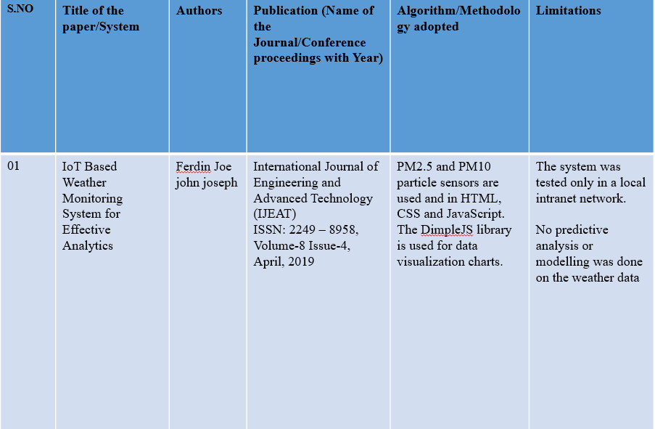

Slide 9
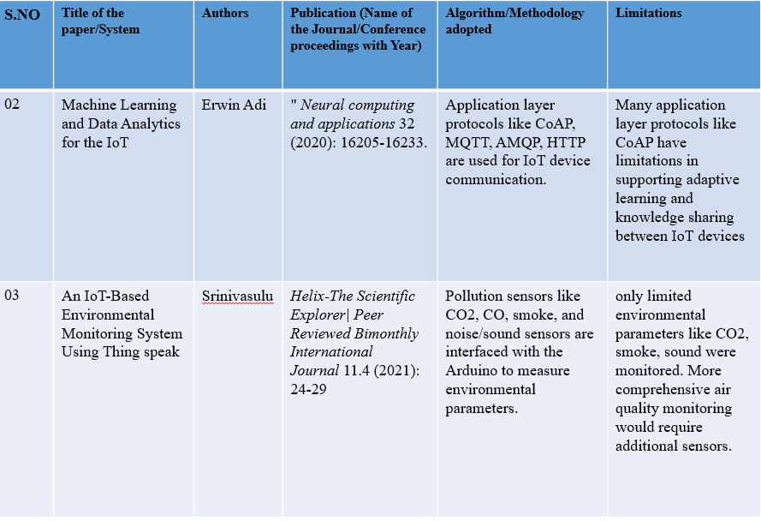

Slide 10
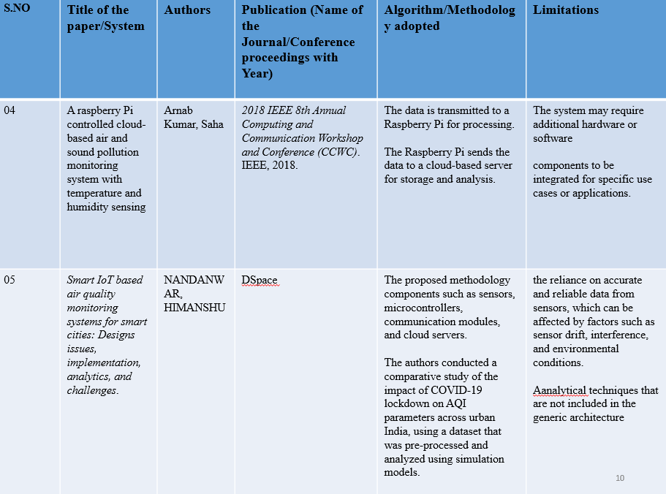

Slide 11
PROBLEM DEFINITION
Urban Pollution Hazards: Urban environments often suffer from rising air and noise pollution levels, leading to potential health risks for individuals, especially those with respiratory conditions. The lack of real-time information and personalized guidance contributes to increased vulnerability to these environmental hazards.
Scenarios:
Air Quality Deterioration: In highly populated urban areas, air pollution levels often spike, presenting significant challenges for individuals with respiratory conditions. Sudden increases in pollutants pose immediate health risks and necessitate timely interventions or guidance.
Noise Pollution Impact: Noise pollution, prevalent in urban settings, can exacerbate existing health conditions, affecting the quality of life for individuals with respiratory issues. Managing exposure to high noise levels becomes crucial for their well-being.

Slide 12
Future Travel Planning: Individuals with respiratory conditions often face uncertainty when planning future travel, especially to areas where pollution levels may significantly impact their health. Lack of guidance on potential risks during travel planning can lead to health hazards.
The "EnviroPredict HealthGuard" project aims to address these scenarios by providing real-time environmental data and personalized guidance, reducing health risks and empowering individuals to make informed decisions about their daily activities and future travel plans.

Slide 13
OBJECTIVE
A functional IoT-based monitoring system that seamlessly collects, transmits and stores patient data from heart and asthma patients.
Reliable predictive models that can accurately identify potential health risks and complications.
Personalized recommendations that empower patients to manage their conditions effectively.
An intuitive user interface accessible through web and mobile applications.
Enhanced patient safety and quality of life by reducing the occurrence of adverse events.
Improved communication and collaboration between patients, caregivers, and healthcare providers.
Contributing to the advancement of IoT-based healthcare technology and patient-centric care.

Slide 14
PROPOSED SYSTEM WORK
This project introduces a comprehensive system designed to revolutionize public health management through proactive environmental monitoring.
By analyzing real-time environmental data, this system offers predictive health alerts, enabling timely precautionary measures to address potential health risks, such as heat-related illnesses or respiratory issues due to air quality.
The integration of IoT sensors ensures continuous monitoring and data collection, empowering the system to provide tailored health recommendations based on the analyzed data.
Furthermore, its alert system, operational via SMS or calls, serves to inform and guide individuals in taking necessary precautions.
Leveraging the ThingSpeak platform, the project allows for accessible real-time data analysis and interpretation.
This adaptable and scalable system fosters improved preparedness among communities and health authorities, offering a forward-looking approach to managing public health.

Slide 15
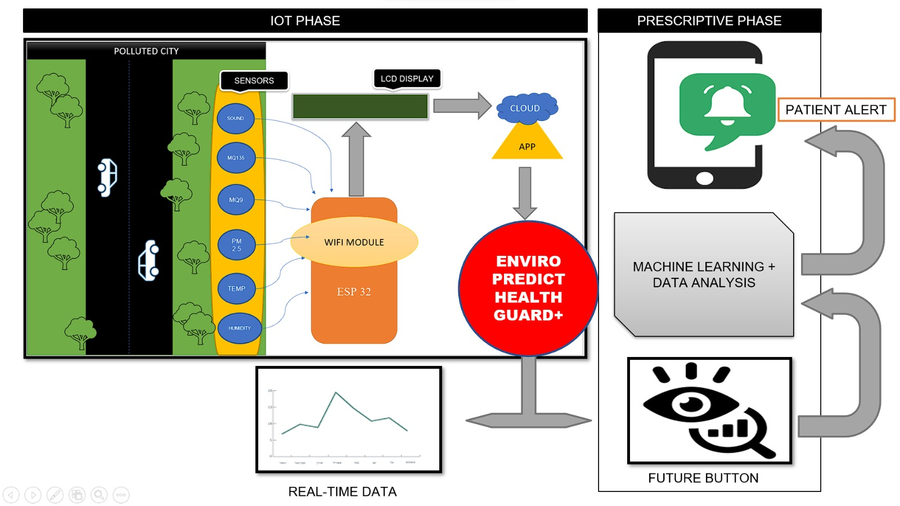
ARCHITECTURE DIAGRAM

Slide 16
CONTRIBUTION OF TEAM MEMBERS
Name: SHAKEEL RIFATH
Contribution: Project Management, IOT device connection, Data cleaning, Data organizing, Model building, and Model deployment Contributing to the research paper, team report and presentation and also Contributing to the research paper.
Name: CONSTANCE XAVIER
Contribution: Finding publication resources.
Name: SRIDHAR
Contribution: Code for Real time graph and Alert system ; Documentation; Programming; Team Presentation; Finding publication resources; Testing; Team Report.

Slide 17
REFERENCE
[1] Cornelius, K., et al. "An efficient tracking system for air and sound pollution using IoT." 2020 6th International conference on advanced computing and communication systems (ICACCS). IEEE, 2020.
[2] Adi, Erwin, et al. "Machine learning and data analytics for the IoT." Neural computing and applications 32 (2020): 16205-16233.
[3] Tahir, Muhammad, et al. "Emas: Environment monitoring and smart alert system for internet of things (iot)." 2020 Global Conference on Wireless and Optical Technologies (GCWOT). IEEE, 2020.
[4] Rault, Tifenn, Abdelmadjid Bouabdallah, and Yacine Challal. ”Energy efficiency in wireless sensor networks: A top-down survey.” Computer Networks 67 (2014): 104-122.
[5] Arampatzis, Th, John Lygeros, and Stamatis Manesis. ”A survey of applications of wireless sensors and wireless sensor networks.” Proceedings of the 2005 IEEE International Symposium on, Mediterrean Conference on Control and Automation Intelligent Control, 2005.. IEEE,2005.

Slide 18
[5] Arampatzis, Th, John Lygeros, and Stamatis Manesis. ”A survey of applications of wireless sensors and wireless sensor networks.” Proceedings of the 2005 IEEE International Symposium on, Mediterrean Conference on Control and Automation Intelligent Control, 2005.. IEEE,2005.
[6] Akkaya, Kemal, and Mohamed Younis. ”A survey on routing protocols for wireless sensor networks.” Ad hoc networks 3.3 (2005): 325-349.
[7] Abbasi, Ameer Ahmed, and Mohamed Younis. ”A survey on clustering algorithms for wireless sensor networks.” Computer communications 30.14- 15 (2007): 2826-2841.
[8] Jindal, V. ”History and architecture of Wireless sensor networks for ubiquitous computing.” International Journal of Advanced Research in Computer Engineering Technology (IJARCET) 7.2 (2018): 214-217.
[9] Ruiz-Garcia, Luis, et al. ”A review of wireless sensor technologies and applications in agriculture and food industry: state of the art and current trends.” sensors 9.6 (2009): 4728-4750. ACM, 2013
[10] Patil, K. A., and N. R. Kale. ”A model for smart agriculture using IoT.” 2016 International Conference on Global Trends in Signal Processing, Information Computing and Communication (ICGTSPICC). IEEE, 2016.

